Slide 1

Does AI- assisted scientific writing
affect readability?
Daniel Duhnev, Marcelo Jiménez, and Lydia Krifka-Dobes1
Universitat Pompeu Fabra (UPF), Barcelona, Spain

Slide 2
Table of contents
01
02
03
04
Research problem
Methodology
Motivation and Research questions
Data acquisition and readability metrics
Results
Conclusion
Readability trends and gradient analysis
Interpretation and discussion of findings

Slide 3
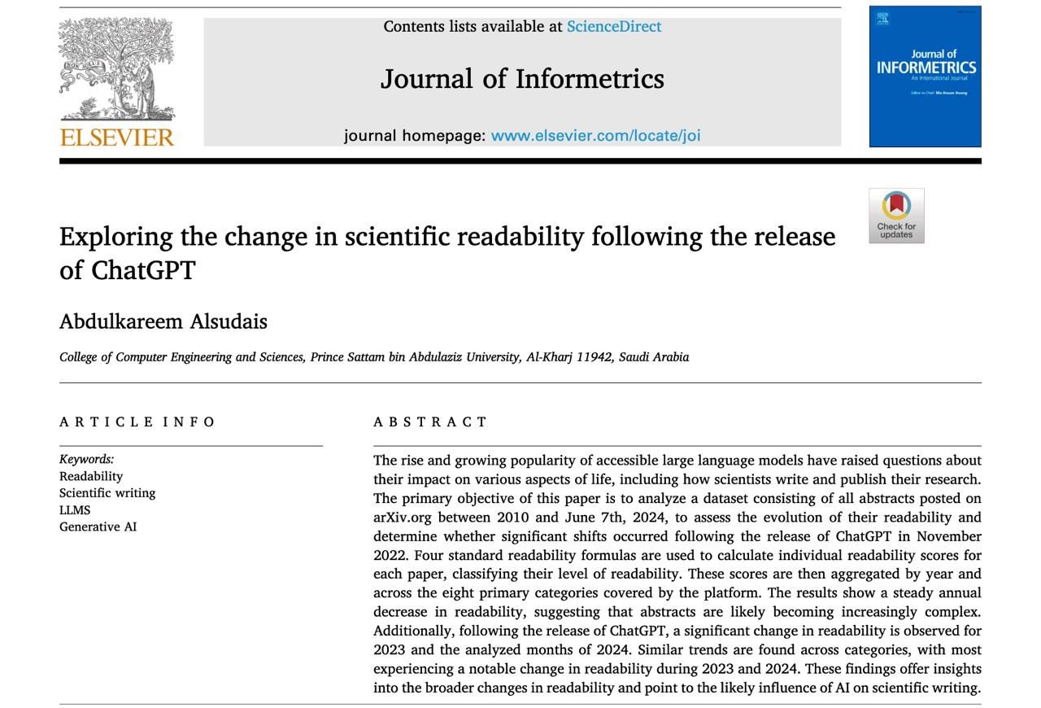
The research problem
(1) ChatGPT released November 2022
→ Researchers started using it for writing
(2) Question:
Did scientific texts become
harder to read?

Slide 4
Our hypothesis
(1) Readability drops sharply after 2022
(Previous studies found this in preprints)
(2) Computer Science papers shows this first
(They adopt new technology earliest)

Slide 5
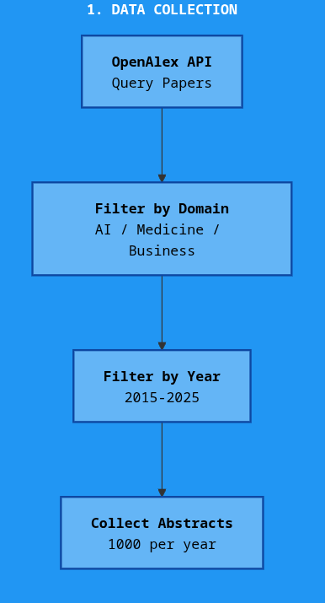
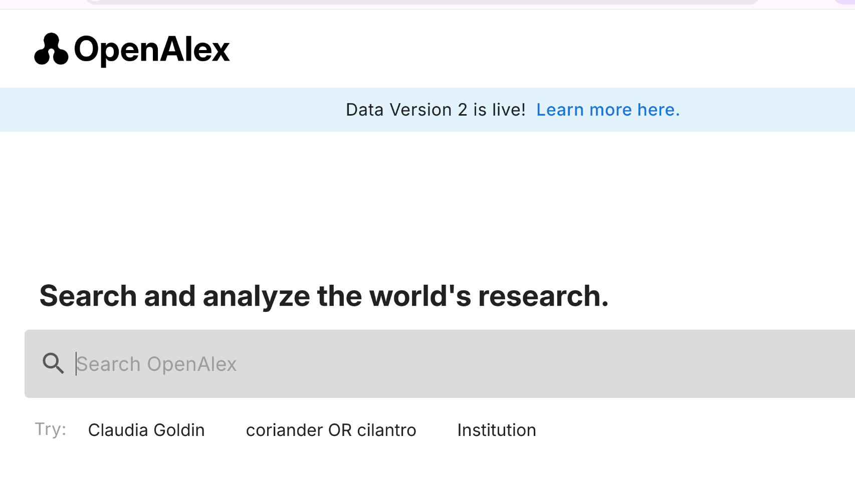

Slide 6
Domains analysed
Computer science
Medicine
Business

Slide 7
Three readability metrics
Flesch-Kincaid Grade Level
→ Sentence length + word length
→ Higher score = needs more education
to understand
Automated Readability Index (ARI)
→ Character count per word
→ Measures visual density of text
Dale-Chall Formula
→ Counts unfamiliar vocabulary
→ Measures jargon density

Slide 8
Abstract:
In an industrial maintenance context, degradation diagnosis is the problem of determining the current level of degradation of operating machines based on measurements. With the emergence of Machine Learning techniques, such a problem can now be solved by training a degradation model offline and by using it online. While such models are more and more accurate and performant, they are often black-bo…
- ARI: 19.0 (dense)
- FKGL: 17.1 (requires Master's degree)
- Dale-Chall: 12.3 (high jargon density)
Notes:
1. Visual Trends Plot average scores over time → Shows overall pattern 2. Gradient Analysis (Segmented Regression) Calculate slope before vs. after 2023 → Did the rate of change accelerate? 3. Acceleration Analysis Find exact inflection point → When did the shift happen?
1. Visual Trends Plot ȳ(t) for t ∈ [2015, 2025] 2. Gradient Analysis m_pre : 2015-2023 m_post : 2023-2025 3. Acceleration Δm = m_post - m_pre

Slide 9
Three-step analysis
Visual trends: Plot average scores over time
Gradient analysis (Segmented regression):
Calculate slope before vs. after 2023
→ m_pre : 2015-2023 m_post : 2023-2025
Acceleration analysis: Find exact inflection point.
Acceleration Δm = m_post - m_pre
→ When did the shift happen?
Notes:
1. Visual Trends Plot average scores over time → Shows overall pattern 2. Gradient Analysis (Segmented Regression) Calculate slope before vs. after 2023 → Did the rate of change accelerate? 3. Acceleration Analysis Find exact inflection point → When did the shift happen?
1. Visual Trends Plot ȳ(t) for t ∈ [2015, 2025] 2. Gradient Analysis m_pre : 2015-2023 m_post : 2023-2025 3. Acceleration Δm = m_post - m_pre

Slide 10
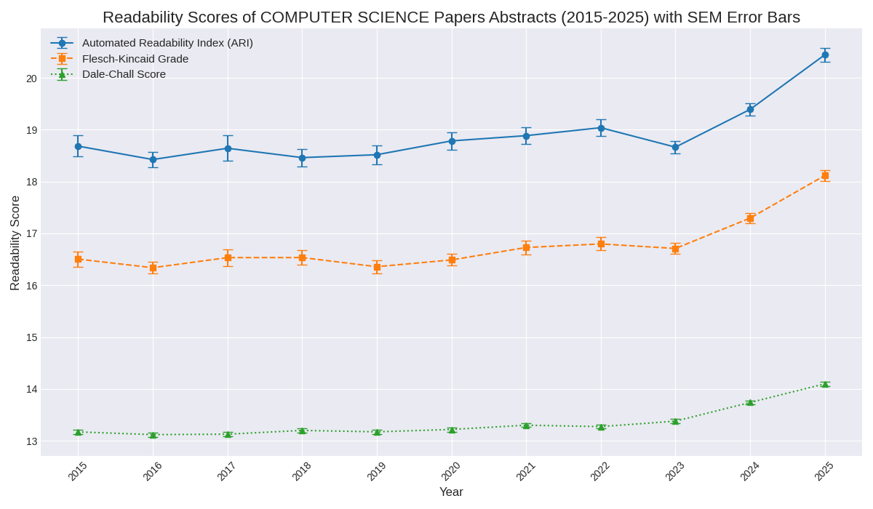
Readability Trends
Notes:
The Visual Trend - simple visual observation
Line graph showing mean scores of each metric over time.
Higher scores mean lower readability i.e. more complex text
Hockey Stick shape of graph - Sharp upward spike starting in 2023
Upward spike happens across all three metrics (FKGL, ARI, Dale-Chall), suggesting the text is getting longer (sentences) and denser (vocabulary)

Slide 11
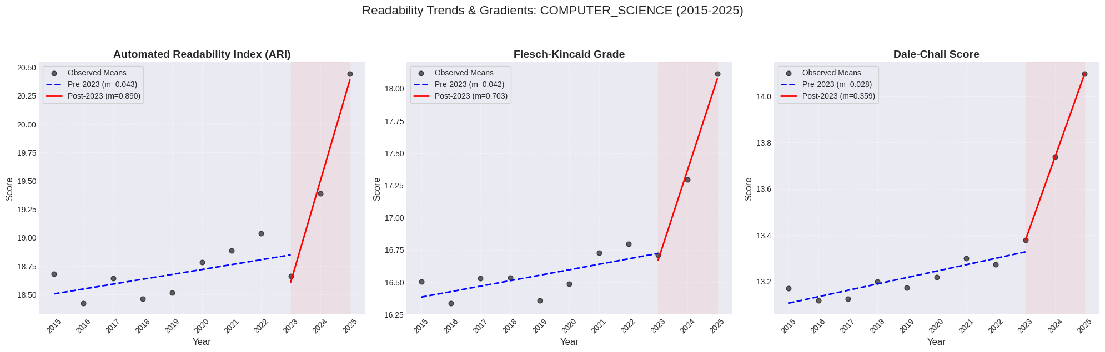
Gradient analysis
Notes:
Gradient Analysis - quantification to confirm result
Used "Segmented Linear Regression" method to measure the rate of change before and after the 2022 release of ChatGPT - up to 2022 and post 2022.
Pre-LLM (Blue Dotted Line) - slope (m) was very low - approx 0.04 for ARI, indicating a slow evolution of language
Post-LLM (Red Solid Line) - slope jumps drastically - more than double to approx 0.9 for ARI
Key Takeaway - The rate of complexity more than doubled after 2022. This proves the visual spike in the previous slide is statistically significant.

Slide 12
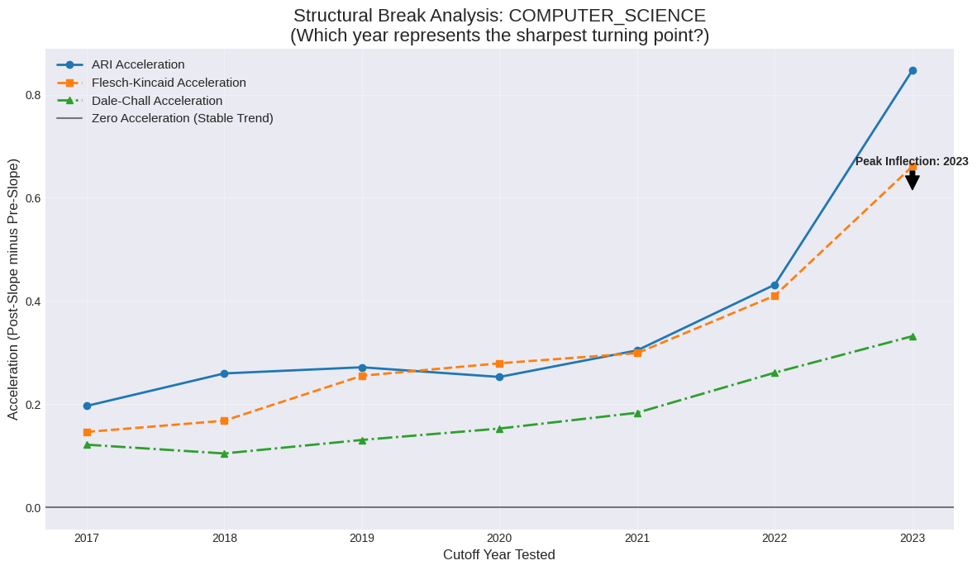
Acceleration analysis
Notes:
Acceleration Analysis - further verification of observed trends
Inflection point: graph identifies the specific year where the change of readability was most drastic.
The Result: The peak is seen at 2023
Early Adopters Hypothesis: Mention that Computer Science shows the "cleanest" signal of the three domains.
Conclusion of this section: This is evidence for hypothesis that AI-related fields, with early adopters of the technology itself, would show the earliest and steepest increase in language complexity and decrease in readability following the release of LLMs

Slide 13
Key Insights - Computer Science Domain
Visual Evidence: A consistent spike appears across all language metrics.
Confirmation: Segmented linear regression confirms the surge is statistically significant. The rate of complexity growth more than doubled comparing pre-2022 to post-2022.
Inflection Point: Acceleration analysis pinpoints 2023 as the year of maximum change.
Conclusion: The Computer Science domain exhibits a statistically significant decline in readability starting in 2023. This trend aligns with the widespread availability of LLMs.

Slide 14
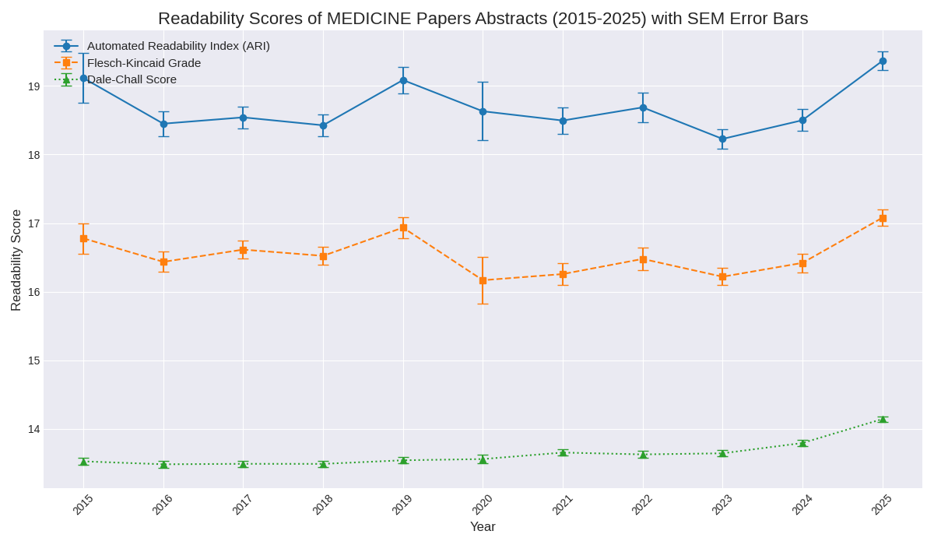
Readability Trends
Notes:
Visual Trends - volatility, then convergence
Visual: Line graph showing mean scores over time
The "Pre-LLM" Noise (2015–2022): Differs from Computer Science. The period 2015–2022 is characterized by high volatility (fluctuations) rather than a steady climb. There was no clear consensus on readability direction during this time.
The "Post-LLM" Convergence (2023–2025): Point to the right side of the graph. Despite the earlier chaos, all three metrics (ARI, FKGL, Dale-Chall) converge into a unified upward spike starting in 2023.
Key Takeaway: The introduction of the external factor (2023) seems to have overridden the natural volatility of the field, forcing a uniform increase in text complexity.

Slide 15
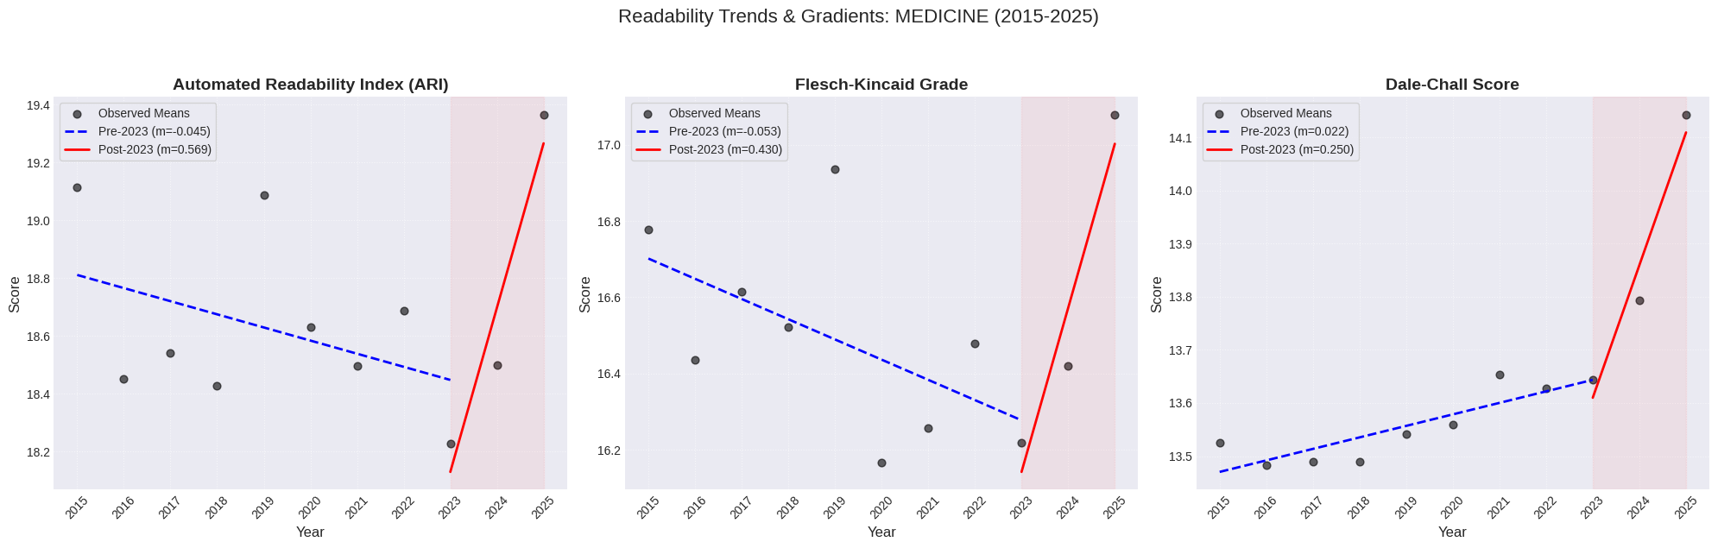
Gradient analysis
Notes:
Gradient Analysis - Quantifying the Shift
Visual: Segmented linear regression plot
Pre-LLM Gradient (Blue Dotted Line): Regression line is an average of that volatile period. Shows a baseline trend, but the data points are scattered widely around it.
Post-LLM Gradient (Red Solid Line): Highlight the shift in 2023. The slope (m) steepens significantly and becomes positive.
The Structural Break: The data points after 2023 follow the regression line more closely than before, suggesting a systematic shift in writing style took hold.

Slide 16
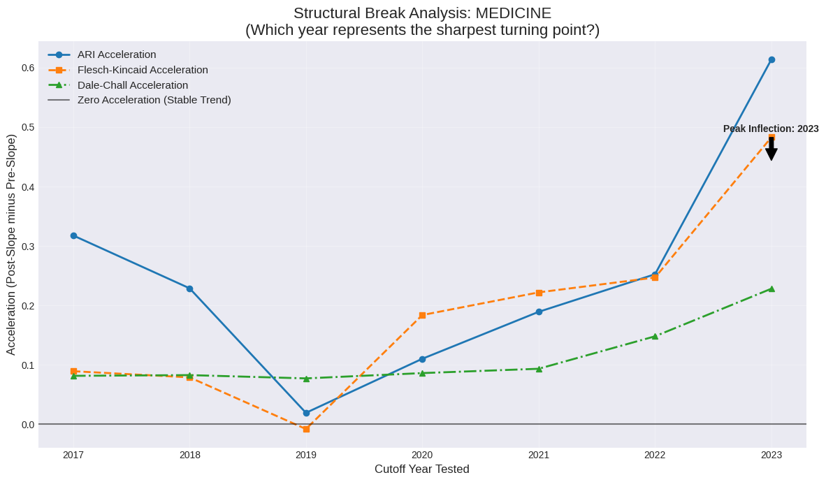
Acceleration analysis
Notes:
Acceleration Analysis
The Result: The acceleration graph shows a distinct peak at 2023, just like Computer Science.
Cross-Disciplinary Phenomenon: This is a crucial validation. It proves that the shift wasn't isolated to Tech/AI fields. The same external pressure (timing correlates with LLM availability) impacted the Medical field at the exact same moment, causing a sharp acceleration in complexity.

Slide 17
Key Insights - Medicine Domain
High year-to-year fluctuation between 2015 and 2022.
All readability metrics converge on a uniform upward spike of increased complexity from 2023 to 2025. Acceleration analysis confirms the peak rate of change occurred in 2023.
Conclusion: Evidence that correlation between decreased readability and the post-LLM era is a cross-disciplinary phenomenon.

Slide 18
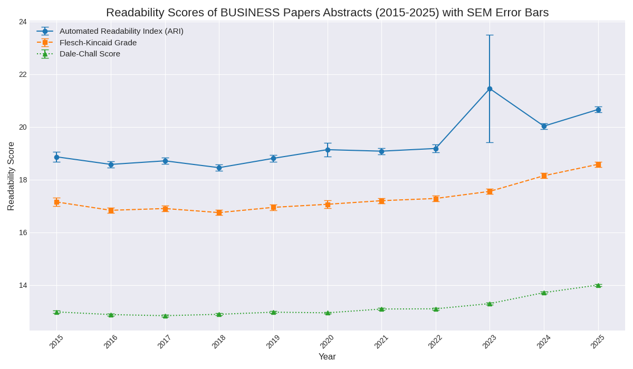
Readability Trends
Notes:
Visual Trends (Rising Baseline & 2023 Uncertainty)
Pre-2023 Trend: Unlike Medicine, the Business domain was less volatile between 2015 and 2022
The 2023 "Shock": Point specifically to the year 2023. Note the massive error bars (shaded region) and the sharp spike. This indicates a moment of high uncertainty and variance in the data. Need to investigate further.
Post-Shock Trajectory: Following the volatile 2023 outlier, the trend stabilizes into a steep upward climb in 2024–2025, consistent with the other domains.

Slide 19
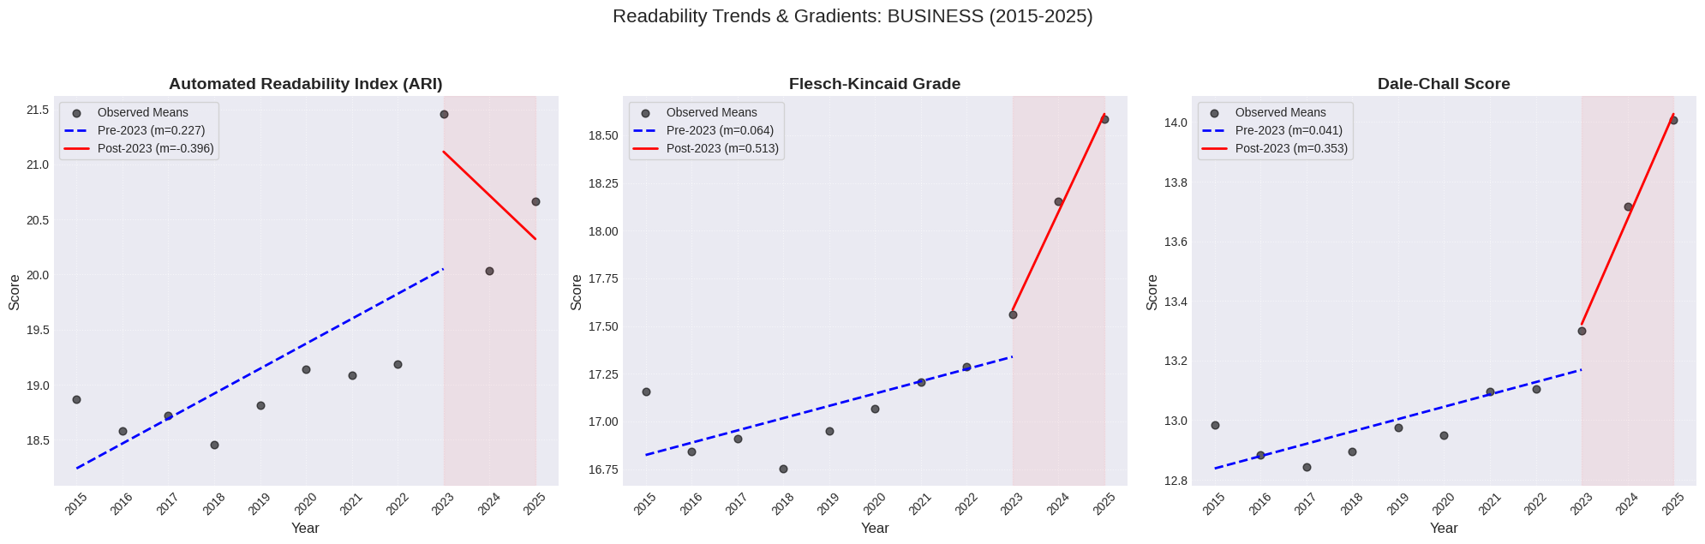
Gradient analysis
Notes:
Gradient Analysis (Acceleration of an Existing Trend)
Pre-LLM Gradient (Blue Dotted Line): Correct the record here: The slope is positive, not zero. Business abstracts were already evolving toward higher complexity before ChatGPT.
Post-LLM Gradient (Red Solid Line): The red line is significantly steeper. The structural break didn't start the trend, it accelerated it.
Key Comparison: The gap between the blue and red lines represents the "added complexity" correlating with the LLM era.

Slide 20
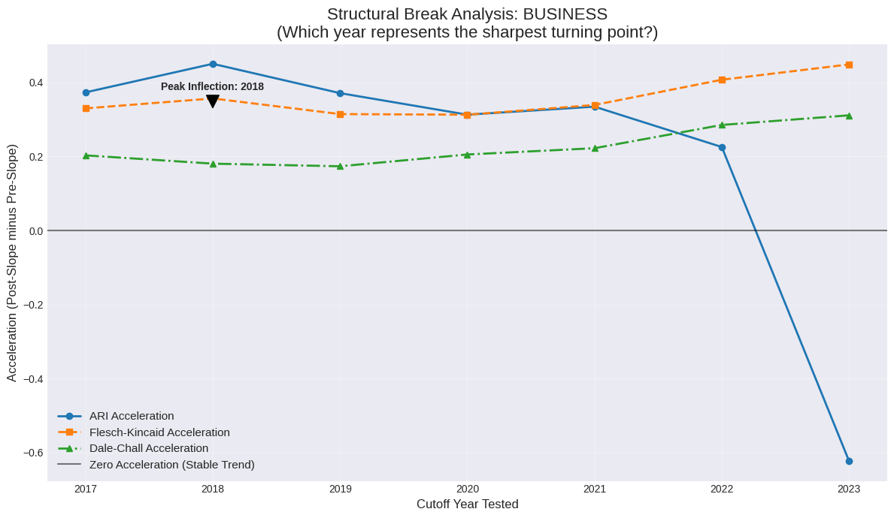
Acceleration analysis
Notes:
Acceleration Analysis (Metric Divergence)
Metric Disagreement: Be transparent about the noise. While Flesch-Kincaid and Dale-Chall show positive acceleration (confirming the trend steepened), ARI shows a sharp negative outlier in 2023.
Interpreting the Divergence: This suggests that while vocabulary became more difficult (Dale-Chall) and sentences longer (FKGL), the specific character-density measured by ARI behaved erratically.
Takeaway: The Business dataset is the "messiest" of the three. The signal is present, but it is complicated by high volatility and metric disagreement at the inflection point.

Slide 21
Key Insights - Business Domain
2023 Outlier: The data shows a data point high uncertainty in 2023, characterized by wide error bars which needs further investigation.
Baseline Growth and Accelerated Decline: Business showed a steady, slow increase in complexity but post-2023, the gradient steepens significantly.

Slide 22
Limitations
Correlation is not Causation: The study cannot verify individual AI usage. It can only correlate the rise of LLMs with decreased readability of various texts.
Limited Scope: Analysis is restricted to abstracts, which represent a standardized summary but may not reflect the full text of the papers.
Metric Blindness: Readability metrics can measure word/sentence length but ignore more subjective meaning or text quality.
Other Factors: Observed trends could partially result from other factors such as field expansion or evolution of field-specific jargon, independent of AI tool use.

Slide 23
Conclusions
A statistically significant increase in language complexity is observed across Computer Science, Medicine, and Business starting in 2023.
Computer Science exhibited the earliest and most stable trend.
The use of LLMs correlates with denser vocabulary and longer sentences. Researchers using AI tools need to be aware of LLMs favouring complexity over readability for scientific writing.
Final Implication: While AI aids productivity, the data warns of a potential trade-off. Technological progress must not come at the expense of scientific clarity.

Slide 24
Thank you!
Do you have any questions?

